Slide 1
Summary of ChatbotGUI
MEGATRON CHATBOT

Slide 2
MainWindow.xaml.cs
The program creates a WPF chatbot interface where users can type messages into an input box and send them using a button click event
User input is processed through a Chatbot class using the GetResponse( ) method, and both user and bot messages are displayed in the chat window
The application uses SpeechSynthesizer from System.Speech.Synthesis to convert the chatbot’s responses into spoken audio for interactive voice feedback

Slide 3
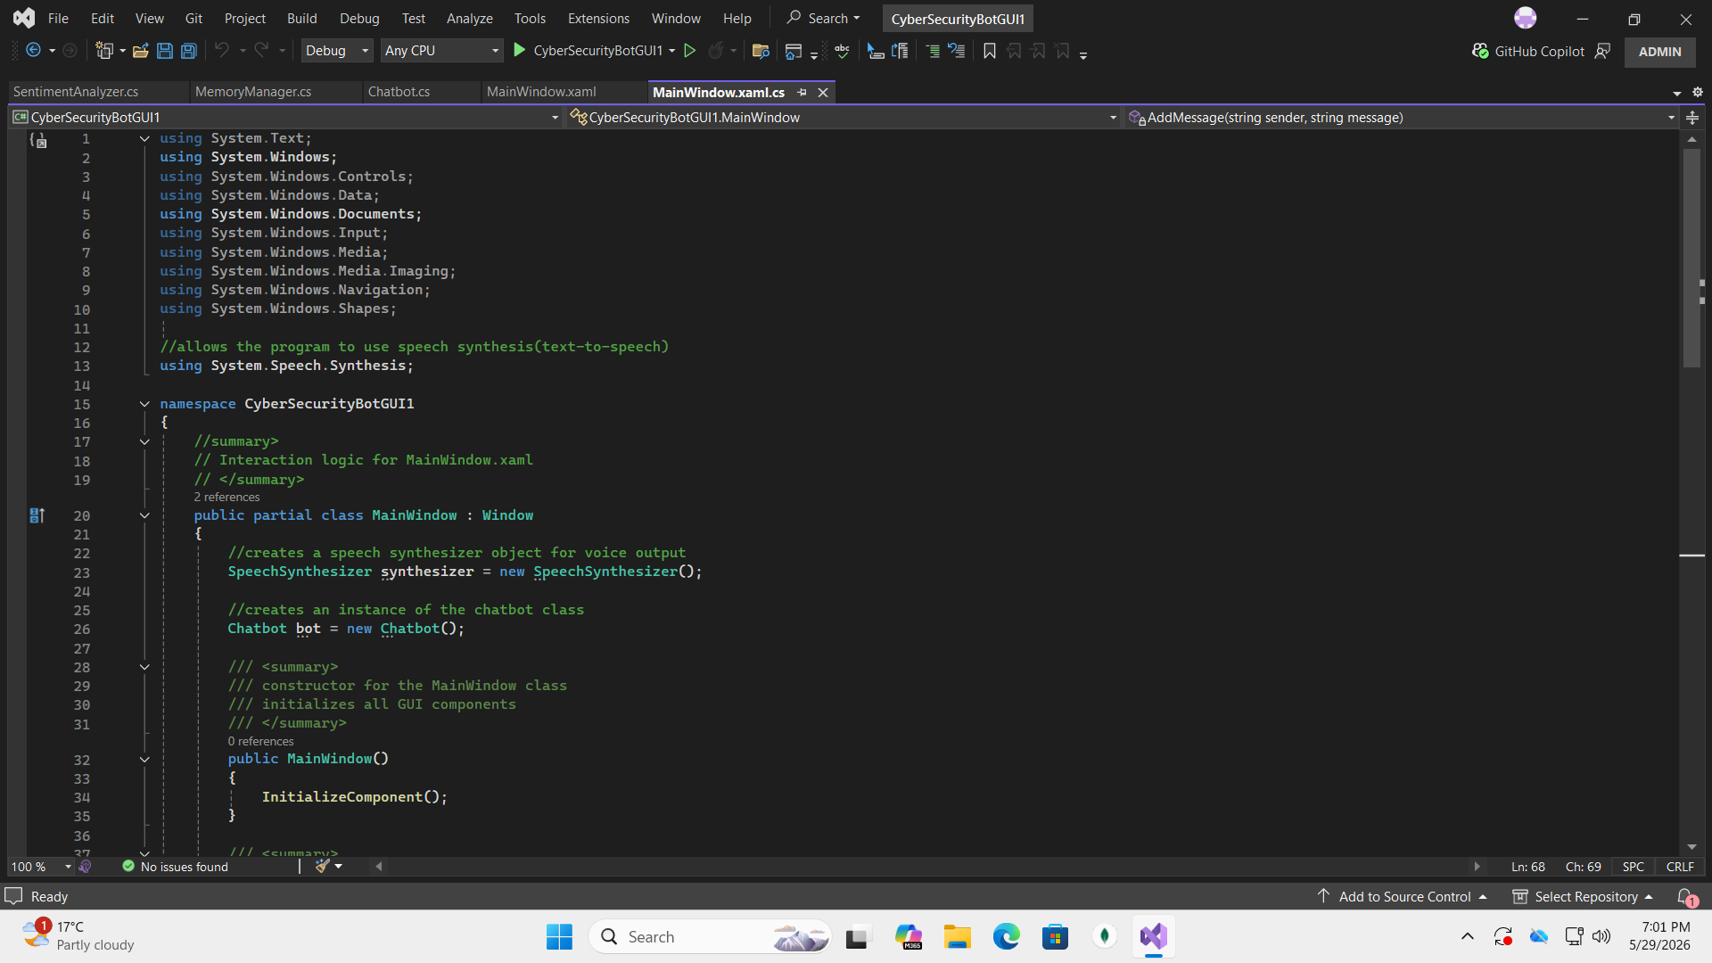
MainWindow.xaml.cs(screenshots)

Slide 4
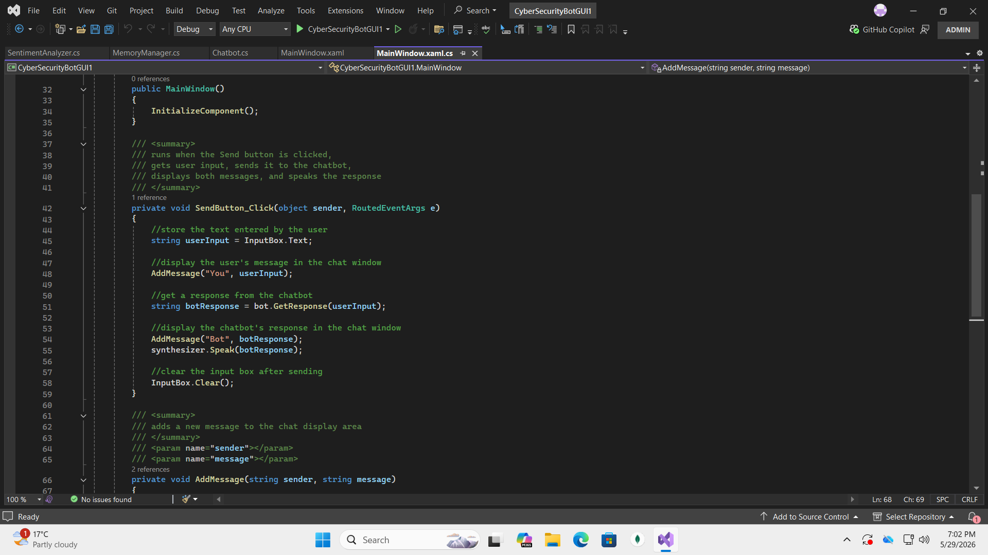
continued

Slide 5
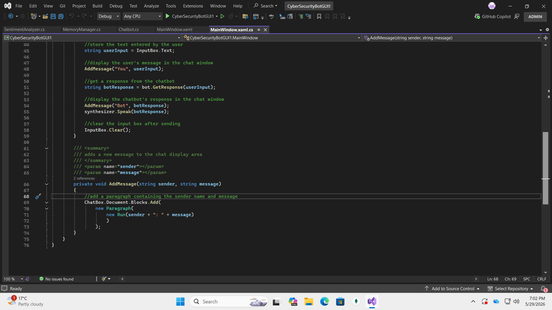
continued

Slide 6
Chatbot.cs
The chatbot uses a dictionary of cybersecurity topics(such as passwords and phishing) to provide relevant advice and randomly selected responses
The program includes sentiment detection, conversation memory, and follow-up responses, allowing the chatbot to react differently when users are worried, confused, or ask for more information
The chatbot validates empty inputs, remembers the last discussed topic, and provides context-aware cybersecurity tips and guidance for safer online behaviour

Slide 7
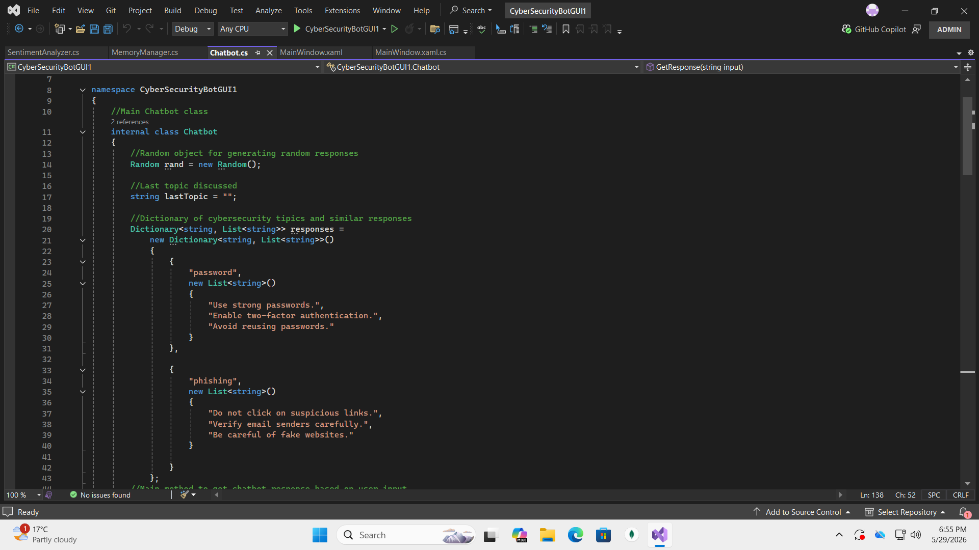
Chatbot.cs (screenshots)

Slide 8
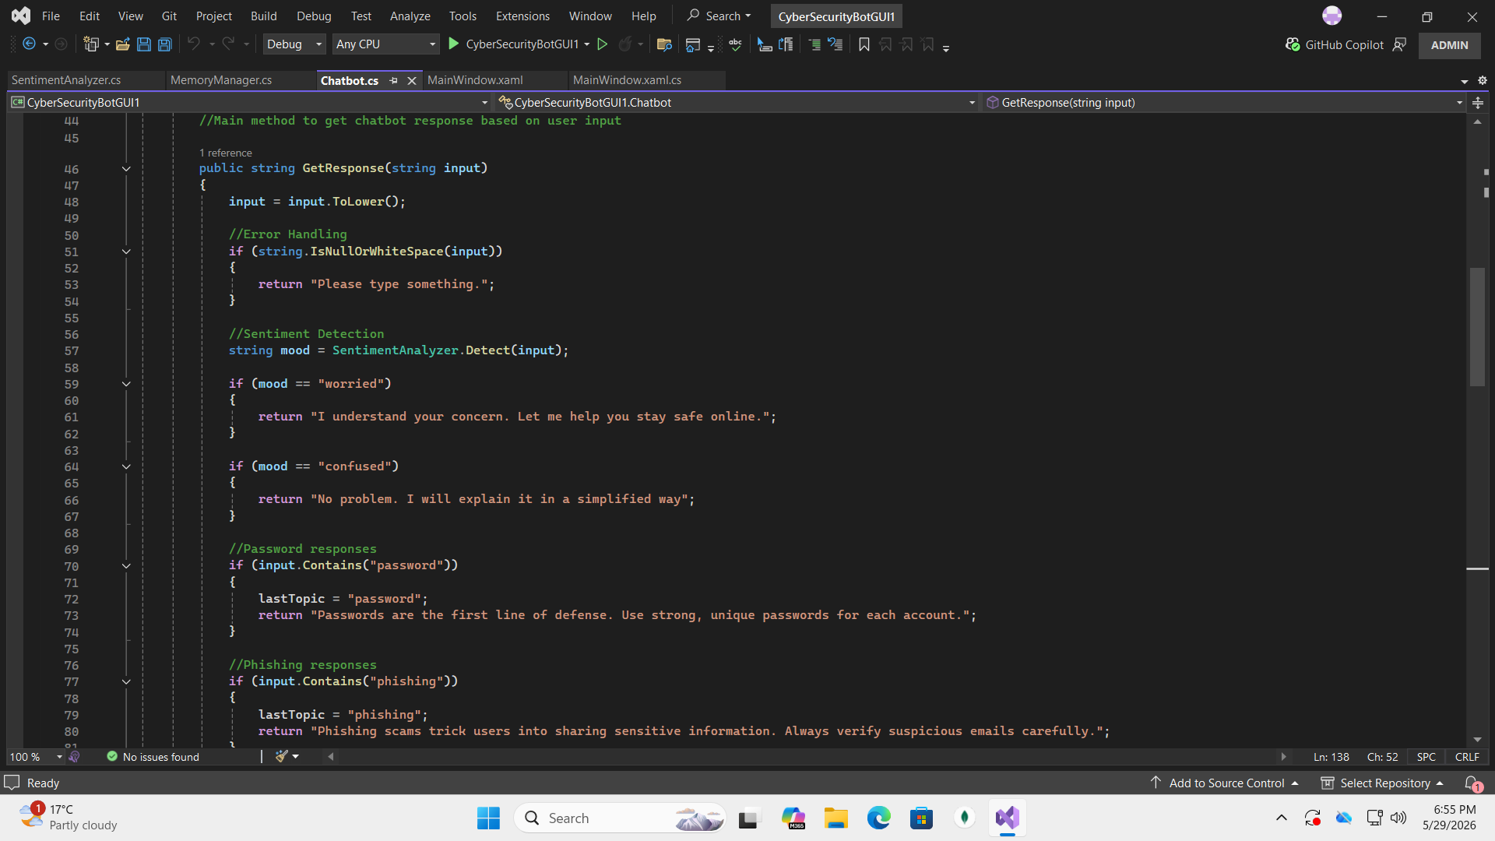
continued

Slide 9
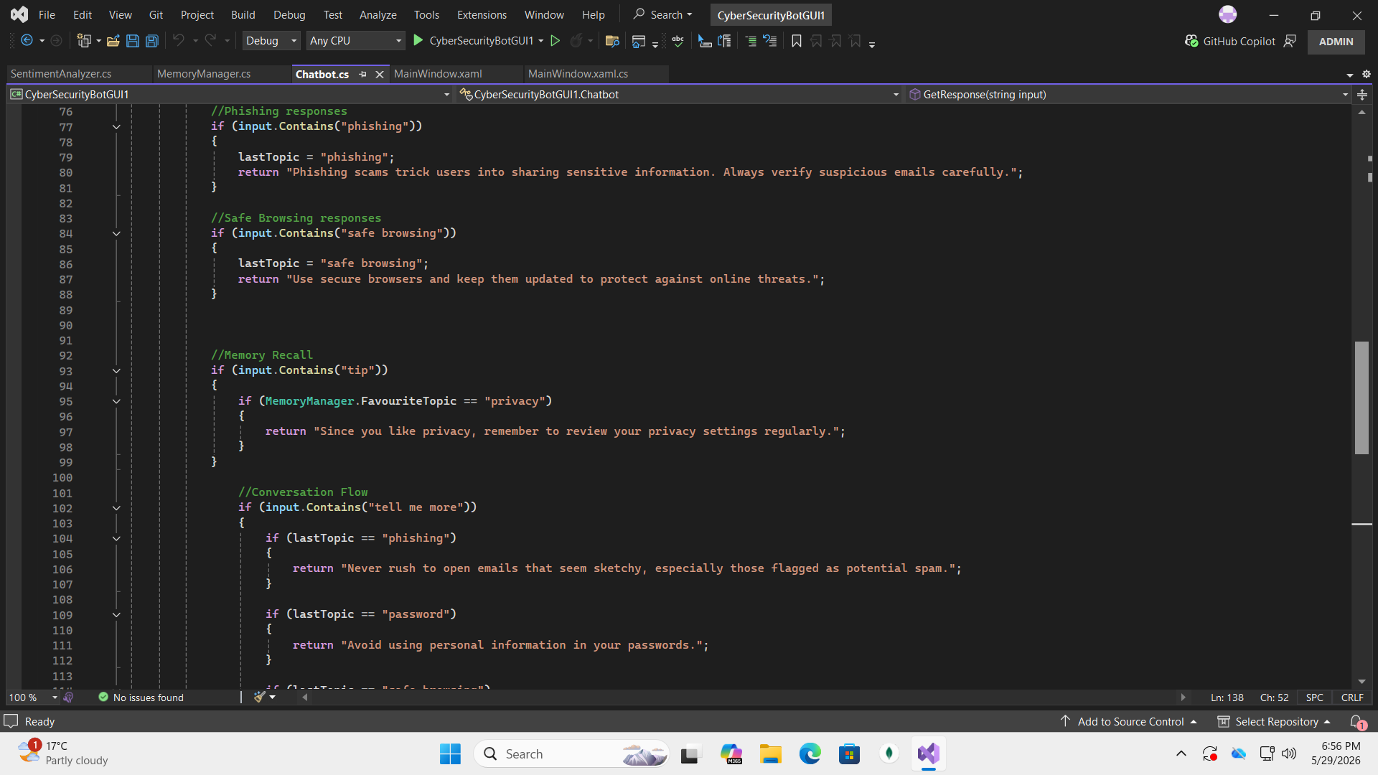
continued

Slide 10
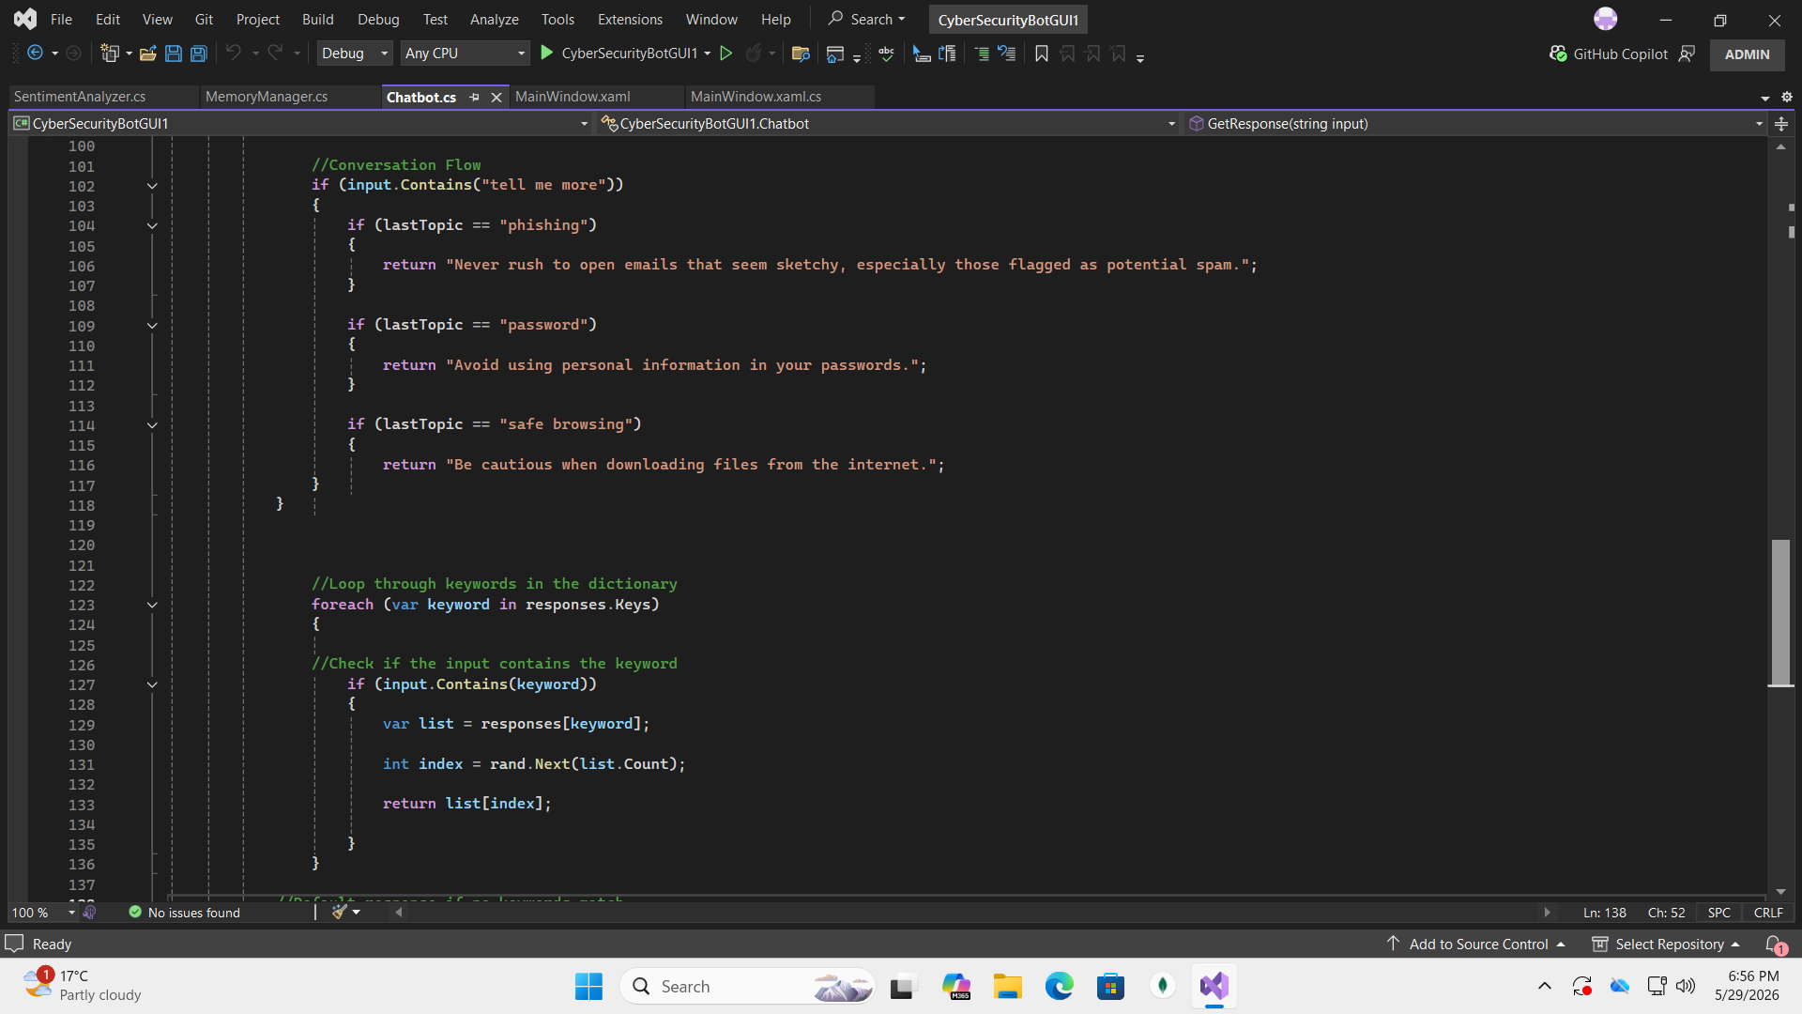
continued

Slide 11
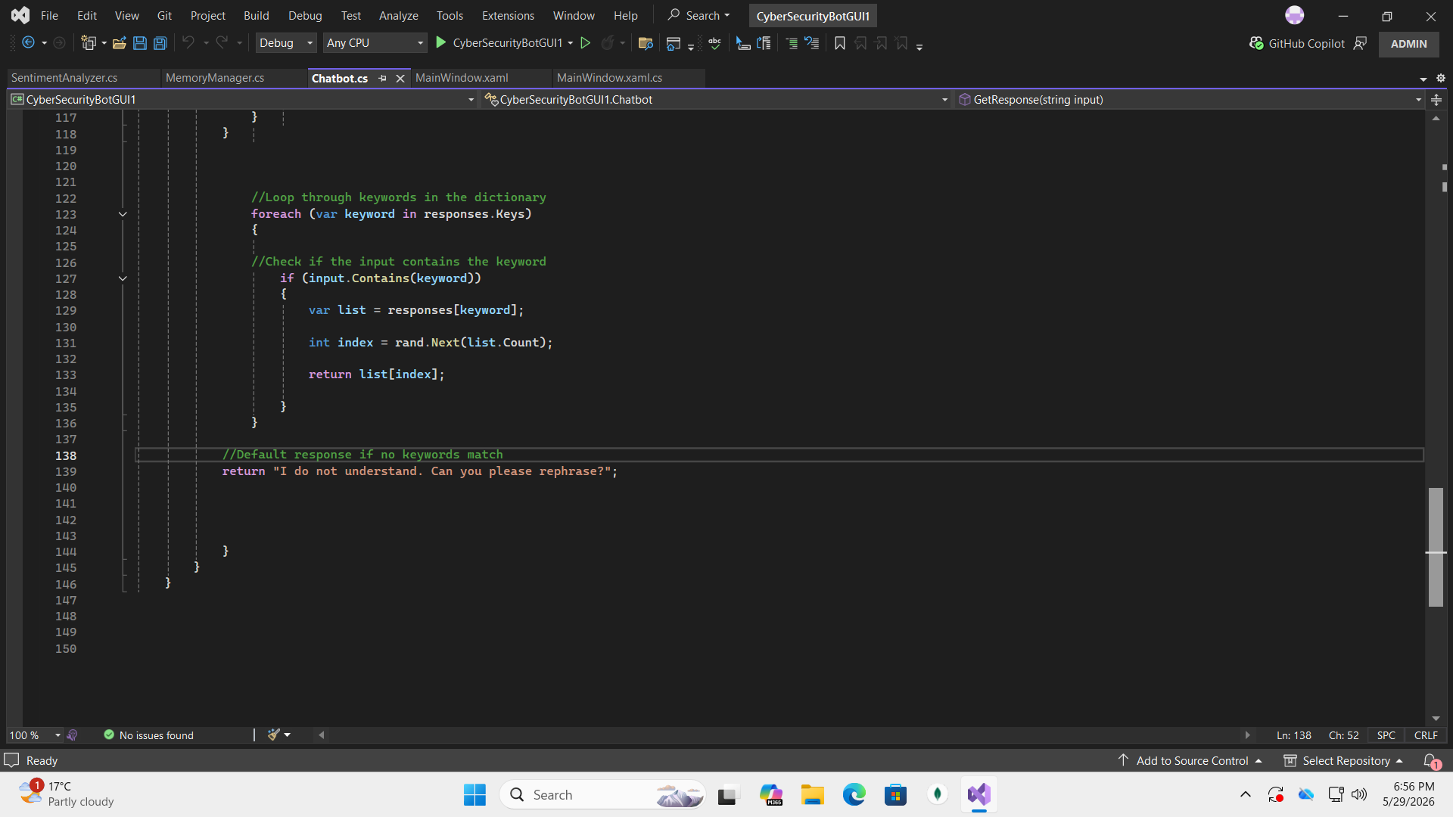
continued

Slide 12
MemoryManager.cs
The MemoryManager class stores a static variable FavouriteTopic, which keeps track of the user’s preferred cybersecurity topic across the application
Because the variable is static, it can be accessed anywhere in the program, allowing the chatbot to personalize responses based on user interests

Slide 13
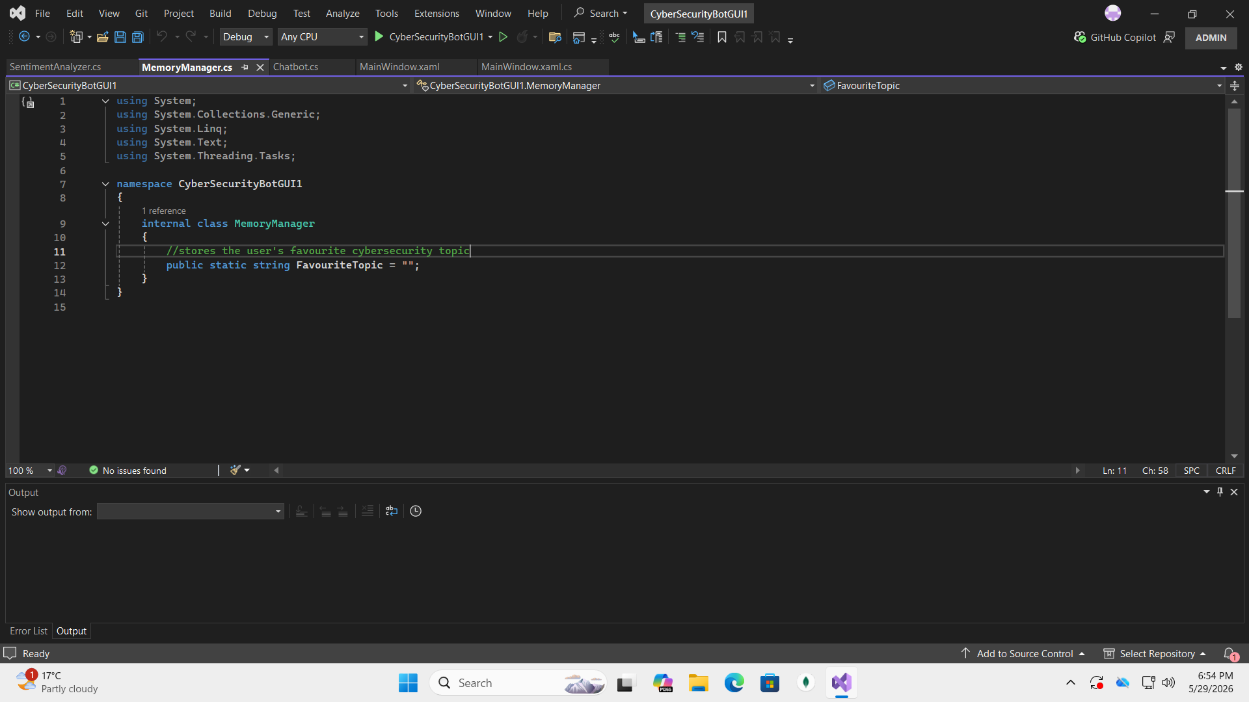
MemoryManager.cs (screenshots)

Slide 14
SentimentAnalyzer.cs
The SentimentAnalyzer class checks user input for keywords like “worried” or “confused” to identify the user’s emotional state
It returns a sentiment label (“worried”, “confused”, or “neutral”) which helps the chatbot adjust its responses based on user emotions

Slide 15
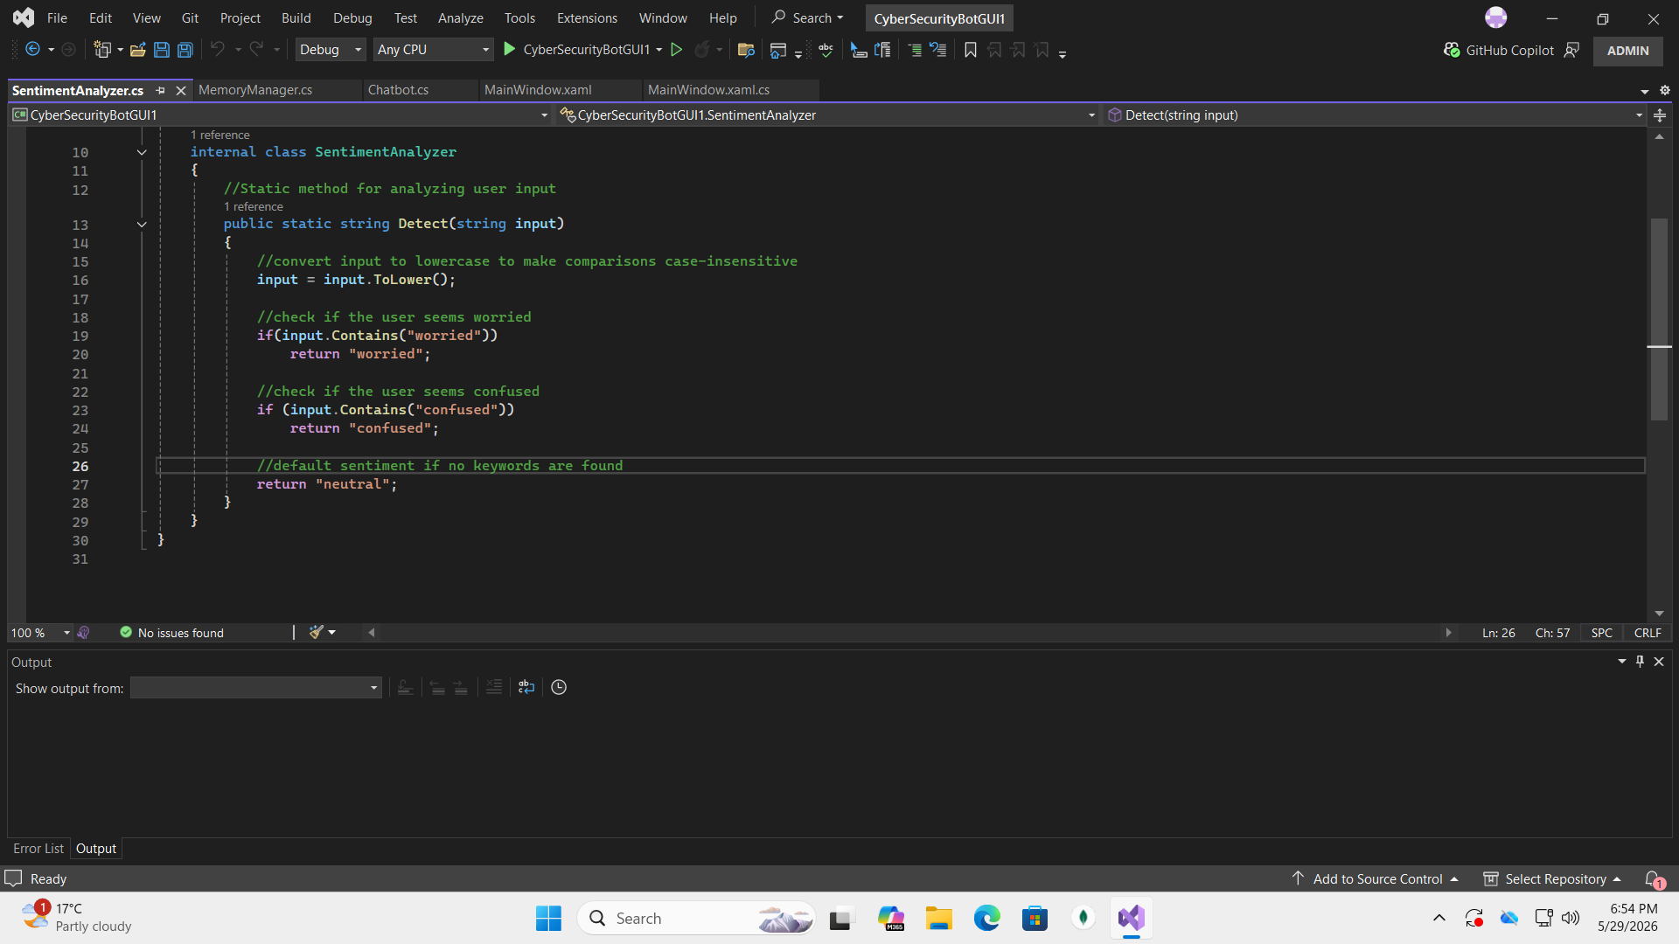
SentimentAnalyzer.cs (screenshots)

Slide 16
MainWindow.xaml
This is where the graphical user interface is designed from scratch using the WPF
Whatever the user comes across first when using the chatbot application, its designs would have come from the MainWindow.xaml
It is because of the MainWindow.xaml that we are able to distinguish between a console chatbot app and a GUI chatbot app

Slide 17
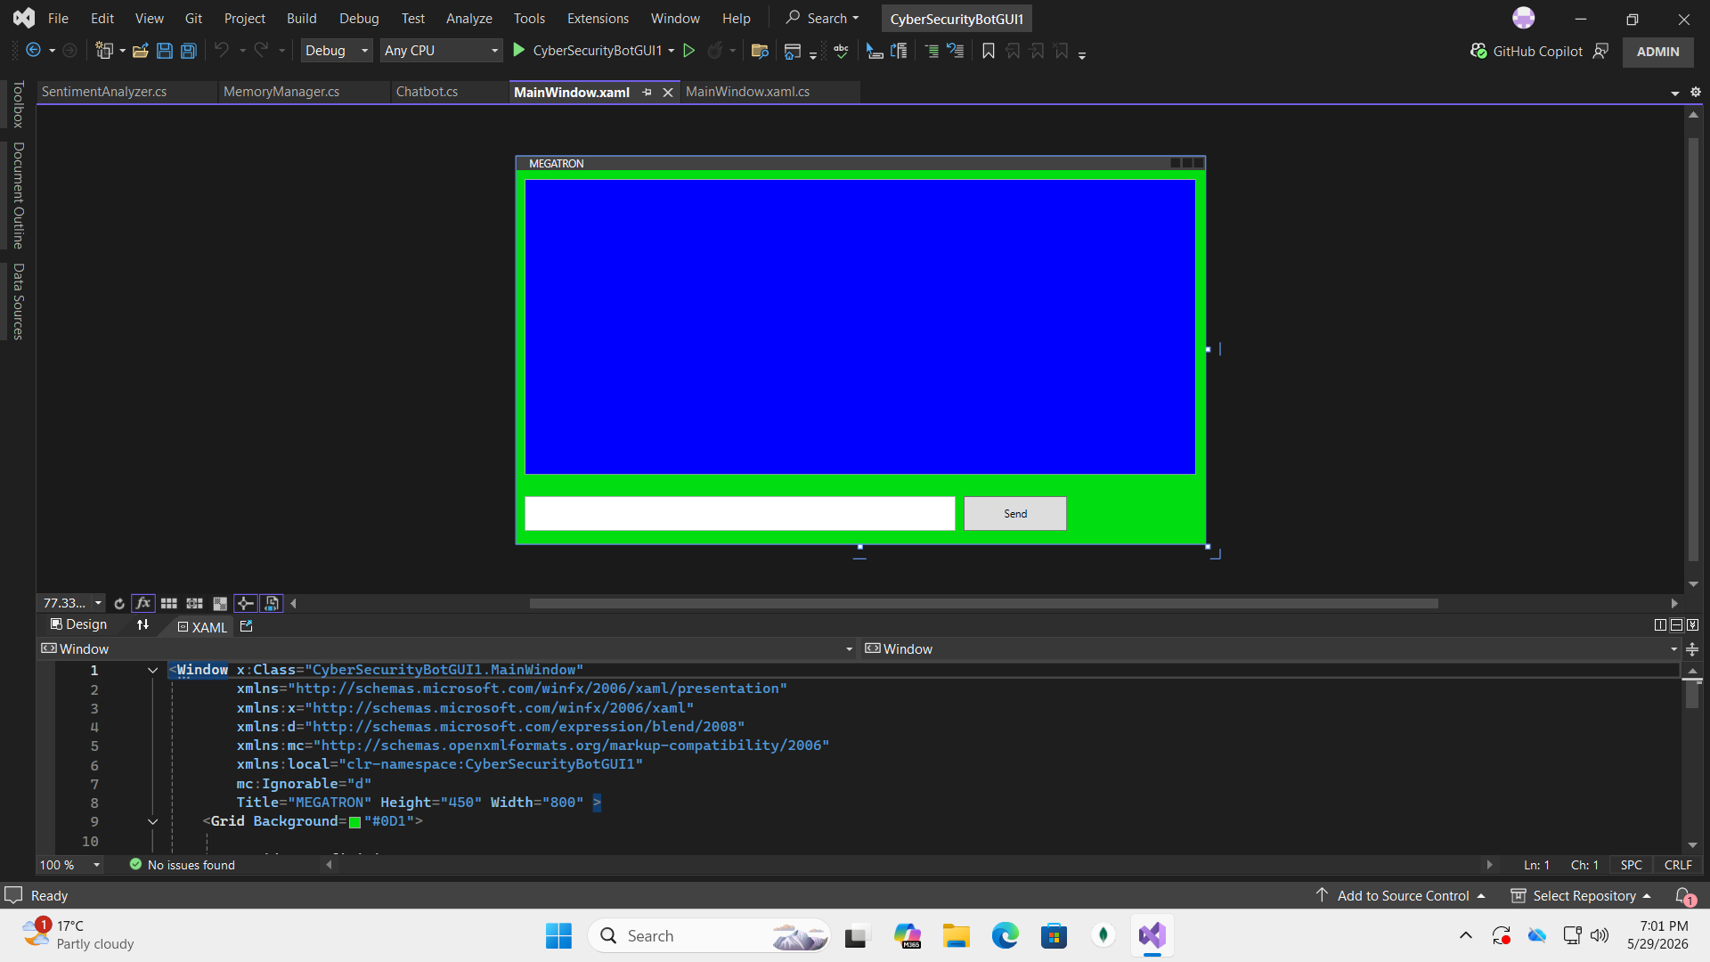
MainWindow.xaml(screenshots)

